Slide 1


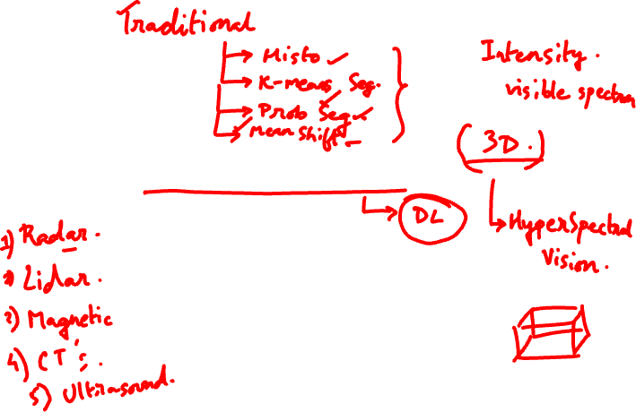
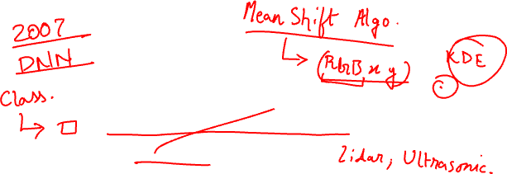
Session #12:
Semantic Segmentation and CV Metrics
Dhruba Adhikary
Dhruba.a@wilp.bits-pilani.ac.in
Acknowledgement: Slide Materials adopted from EECS 442 – David Fouhey
1
Winter 2023, University of Michigan

Slide 2
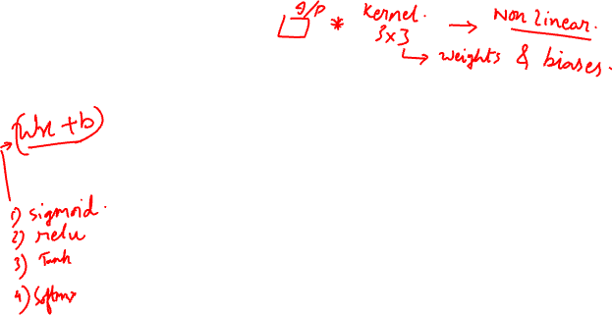
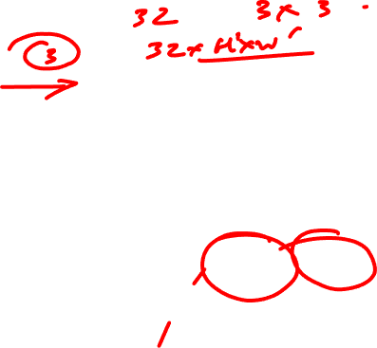
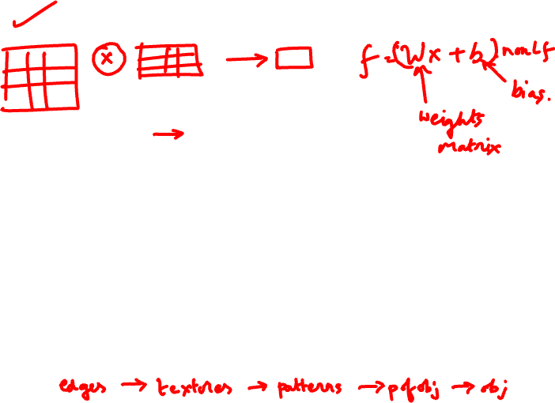
Convolutional Neural Network (CNN)
CV 12: Semantic Segmentation and CV Metrics
W
2
b₂
W
3
b₃
x
C
f(n)
C
f(n)
C
f(n)

Slide 3
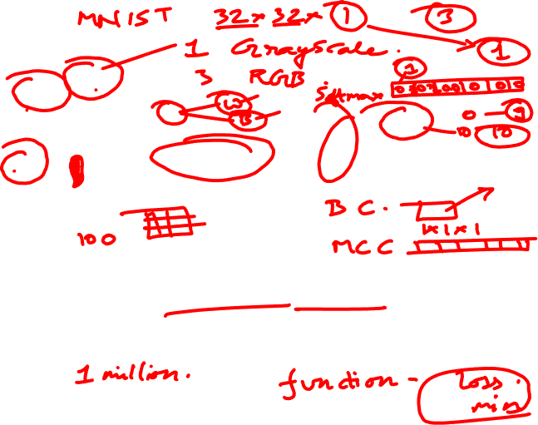
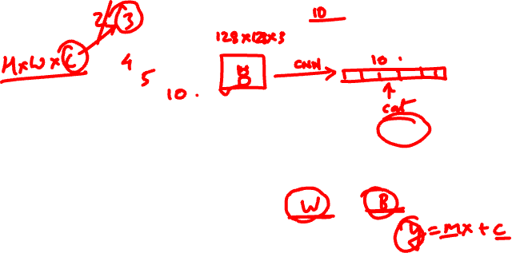
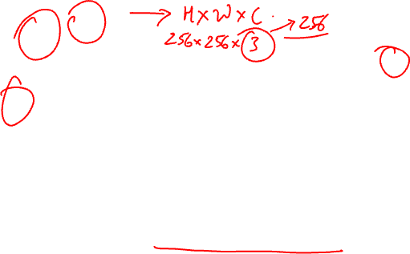
CNN
CV 12: Semantic Segmentation and CV Metrics
C
W
1
1
F
CNN
H
Function of the image that is parameterized by the convolutional filter weights and biases. We design the form of the function and fit the parameters to data.
Notes:
For one dimension,
$$\boxed{O=\left\lfloor \frac{N−K+2P}{S}\right\rfloor +1}$$
where
$N$= input size
$K$= kernel size
$P$= padding
$S$= stride
$\left\lfloor ⋅\right\rfloor$= floor (round down)

Slide 4
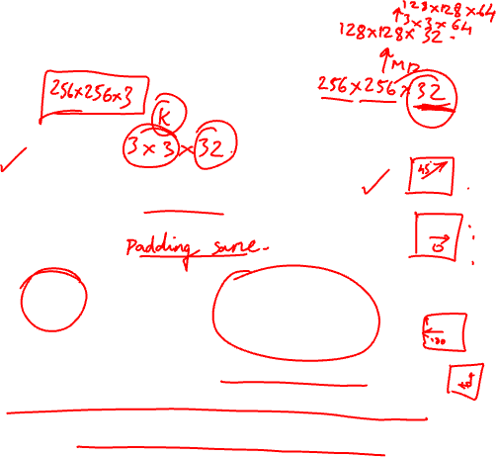
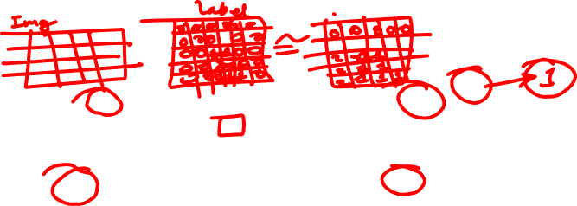
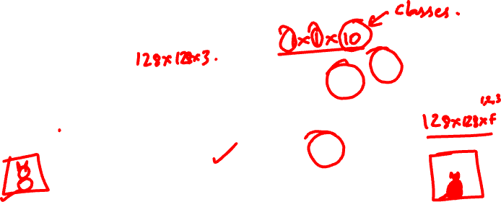
Now
CV 12: Semantic Segmentation and CV Metrics
C
F
W
W
CNN
H H
Convert HxW image into a F-dimensional vector
Which pixels in this image are a cat?
How far is each pixel away from the camera?
Which pixels of this image are fake?

Slide 5
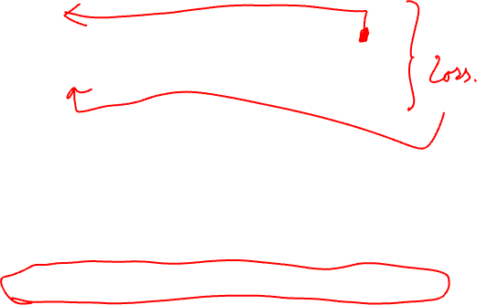
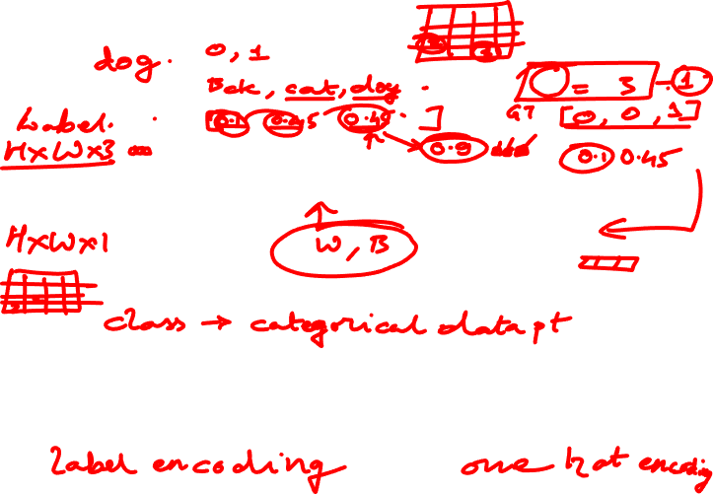
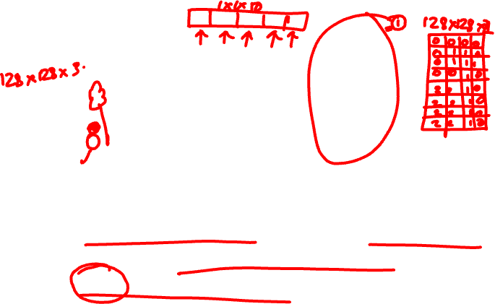
Semantic Segmentation
CV 12: Semantic Segmentation and CV Metrics
C
F
W
W
CNN
H
H
Today’s Running Example
Predict F-dimensional vector representing probability of each of F classes at every pixel
Loss computed/backprop’d at every pixel.

Slide 6
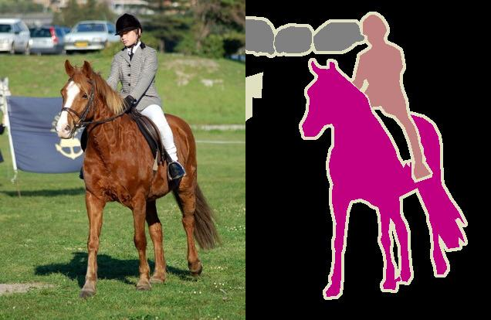
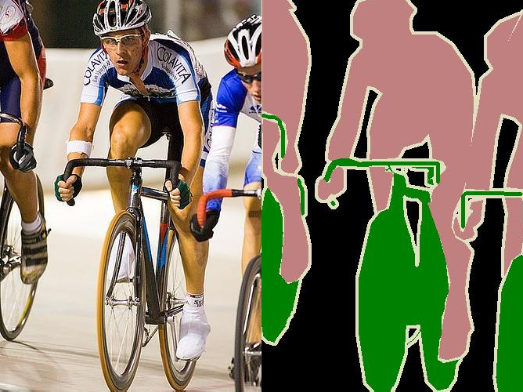
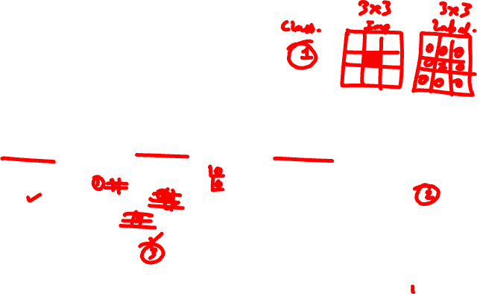
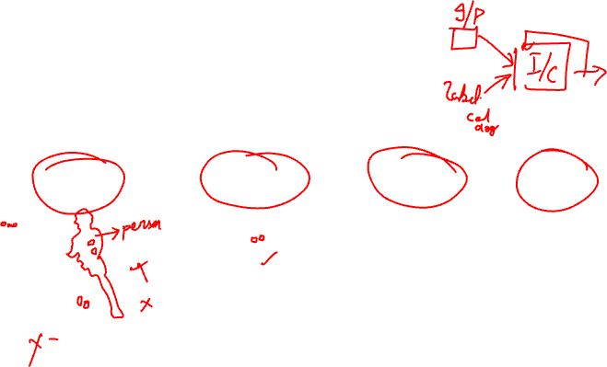
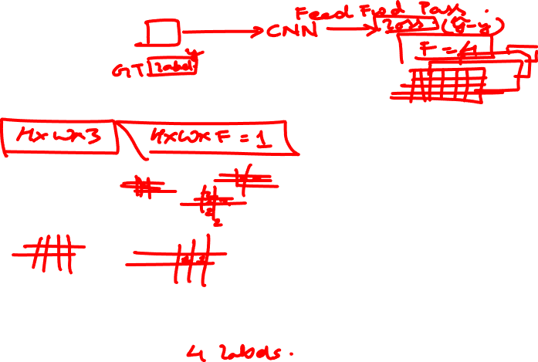
Semantic Segmentation
CV 12: Semantic Segmentation and CV Metrics
Each pixel has label Usually visualized by colors.
Note: don’t distinguish between object instances
Input Label Input Label
Image Credit: Everingham et al. Pascal VOC 2012.

Slide 7


Semantic Segmentation
CV 12: Semantic Segmentation and CV Metrics
“Semantic”: a usually meaningless word and an indication that someone is trying to trick you.
Meant to indicate here that we’re naming things.
Input Label Input Label

Slide 8


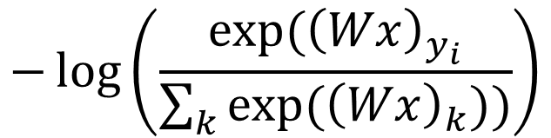
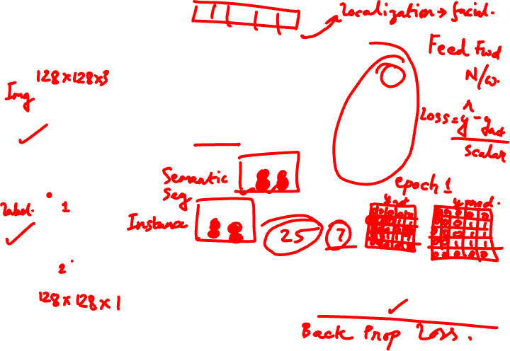
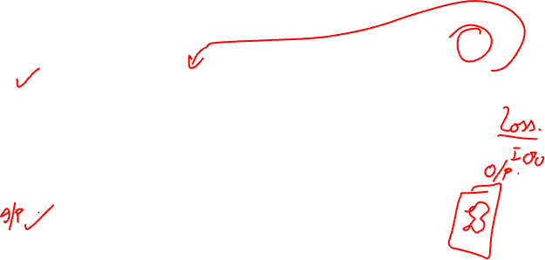
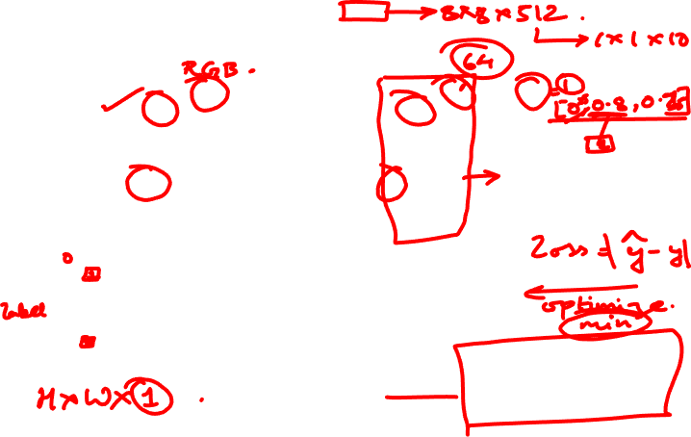
Semantic Segmentation
CV 12: Semantic Segmentation and CV Metrics
3
F _{W} F
W
W
H
CNN
H
H
F-way classification loss function
at every pixel:
Image Credit: Everingham et al. Pascal VOC 2012.

Slide 9
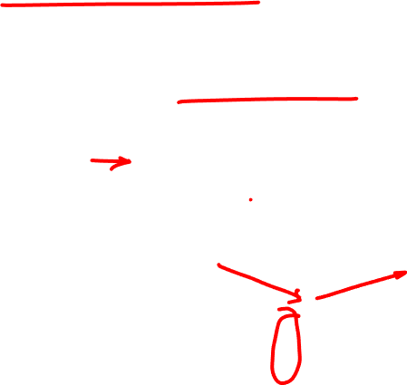
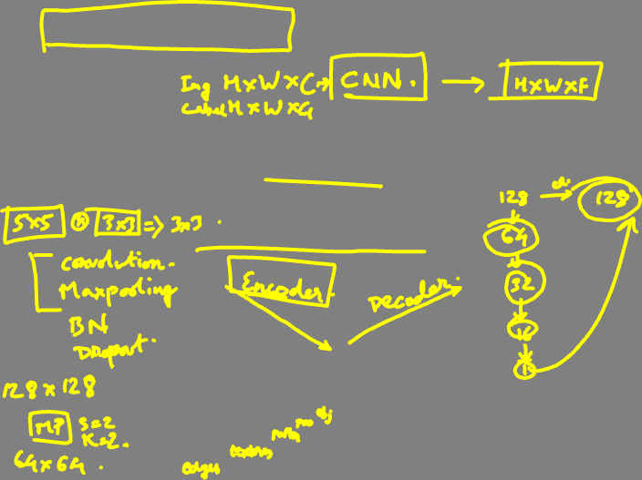
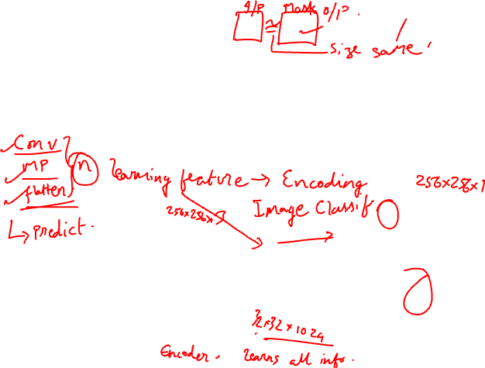
Encoder-Decoder
CV 12: Semantic Segmentation and CV Metrics
Key idea: First downsample towards middle of network. Then upsample from middle.
How do we downsample?
Convolutions, pooling
C _{W}F
W
H
H
Notes:
Output Formula
$$\boxed{O=\left(I−1\right)×S−2P+K+\text{Output} \text{Padding}}$$
where
$I$= input size
$S$= stride
$P$= padding
$K$= kernel size

Slide 10


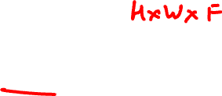
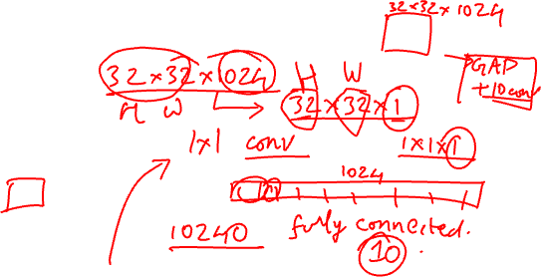
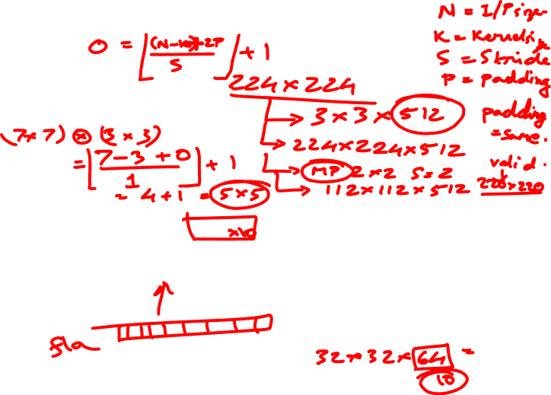
Where Do We Get Parameters?
CV 12: Semantic Segmentation and CV Metrics
Convnet that maps images to vectors
224
1x1
Recall that we can rewrite any vector-vector operations via 1x1 convolutions
Long et al. Fully Convolutional Networks For Semantic Segmentation. CVPR 2014
Notes:
For one dimension,
▭(𝑂=⌊(𝑁−𝐾+2𝑃)/𝑆⌋+1)
where
𝑁= input size
𝐾= kernel size
𝑃= padding
𝑆= stride
⌊⋅⌋= floor (round down)

Slide 11

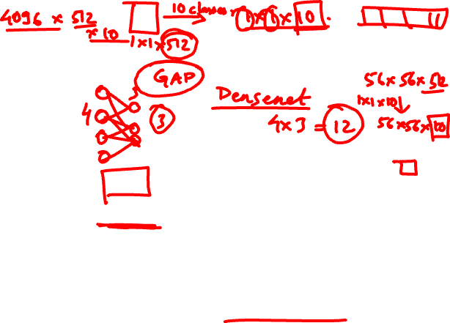
Where Do We Get Parameters?
CV 12: Semantic Segmentation and CV Metrics
Convnet that maps images to vectors
224
Convnet that maps images to images
224
1x1
1x1
What if we make the input bigger?

Slide 12
Where Do We Get Parameters?
CV 12: Semantic Segmentation and CV Metrics
Convnet that maps images to vectors
224
Convnet that maps images to images
500
1x1
10x10
Since it’s convolution, can reuse an image network

Slide 13
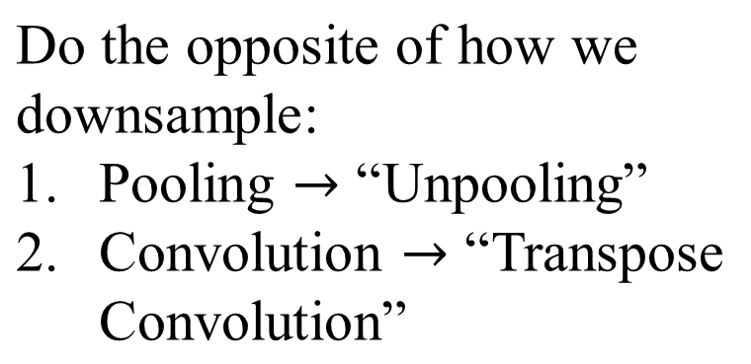
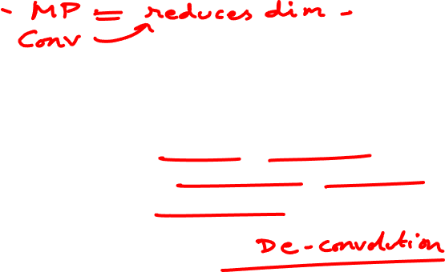
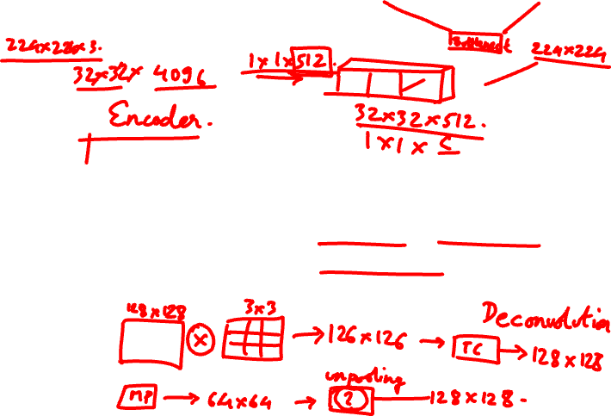
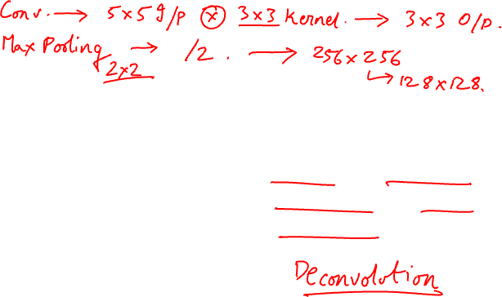
How Do We Upsample?
CV 12: Semantic Segmentation and CV Metrics
2W ^{F}
W H
C
2H

Slide 14
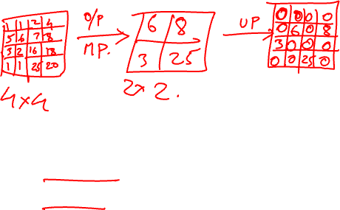
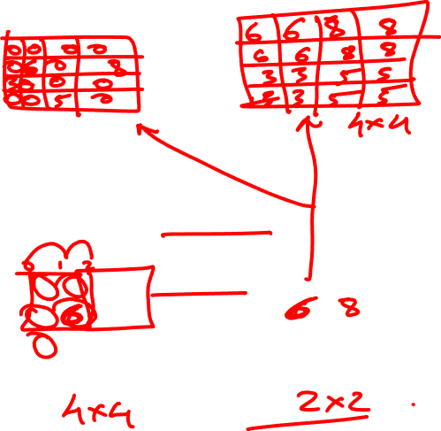
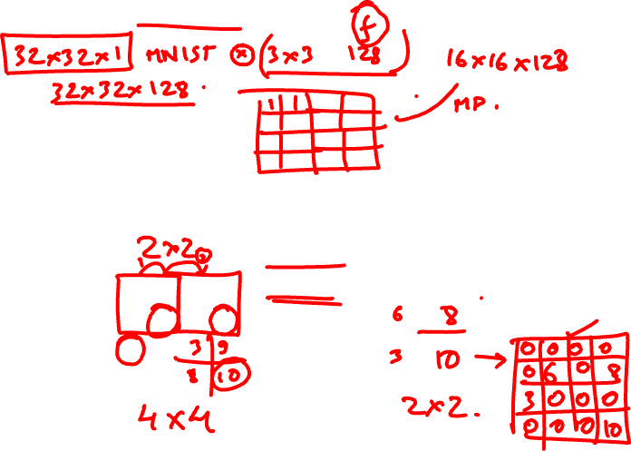
Recall: Pooling
CV 12: Semantic Segmentation and CV Metrics
Max-pool 2x2 Filter Stride 2
1 | 1 | 2 | 4
5 | 6 | 7 | 8
3 | 2
1 | 1
8
6
3

Slide 15
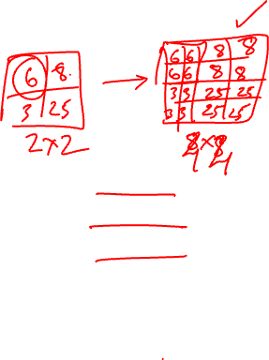
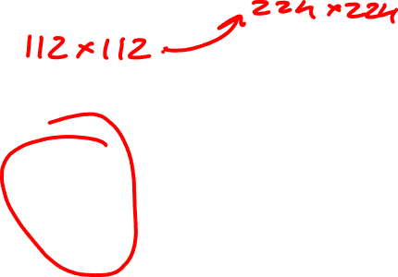
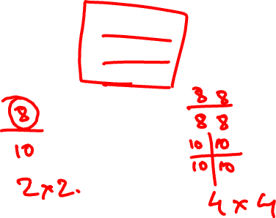
Now: Unpooling
CV 12: Semantic Segmentation and CV Metrics
Nearest Neighbor Unpool x2
8 | 8 | 6 | 6
8 | 8 | 6 | 6
 |  | 3 | 3
 |  | 3 | 3
8
6
3

Slide 16

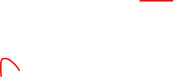
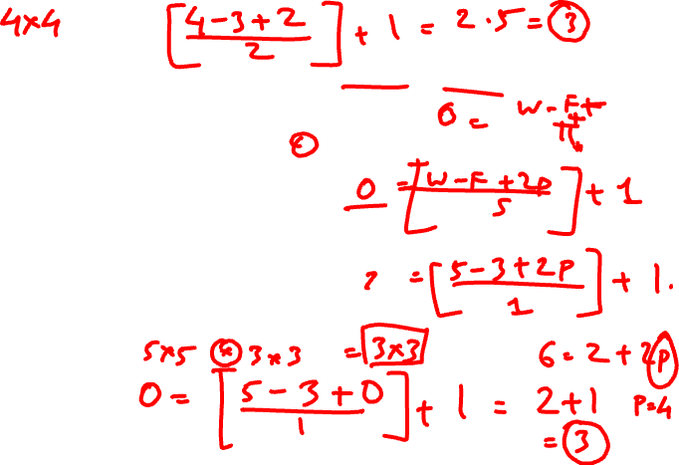
Recall: Convolution
CV 12: Semantic Segmentation and CV Metrics
3x3 Convolution, Stride 2, Pad 1
Dot product between filter f and input
Example Credit: L. Fei-Fei, J. Johnson, S. Yeung

Slide 17
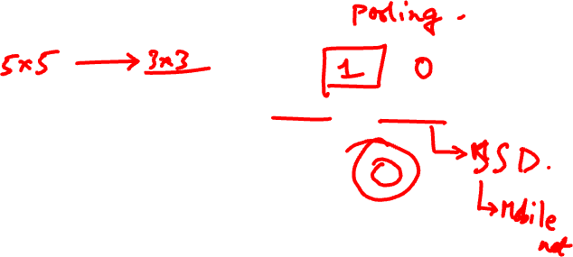
Recall: Convolution
CV 12: Semantic Segmentation and CV Metrics
3x3 Convolution, Stride 2, Pad 1
Dot product between filter f and input
Example Credit: L. Fei-Fei, J. Johnson, S. Yeung

Slide 18
Recall: Convolution
CV 12: Semantic Segmentation and CV Metrics
3x3 Convolution, Stride 2, Pad 1
Example Credit: L. Fei-Fei, J. Johnson, S. Yeung

Slide 19
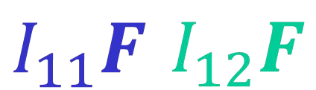
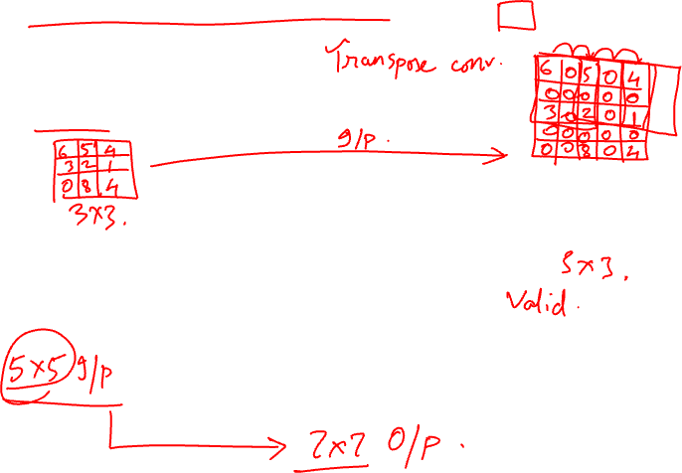
Transpose Convolution
CV 12: Semantic Segmentation and CV Metrics
3x3 Transpose Convolution, Stride 2, Pad 1
Output is filter F weighted by input I
I11
I12
Example Credit: L. Fei-Fei, J. Johnson, S. Yeung

Slide 20
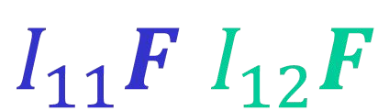
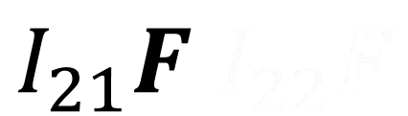
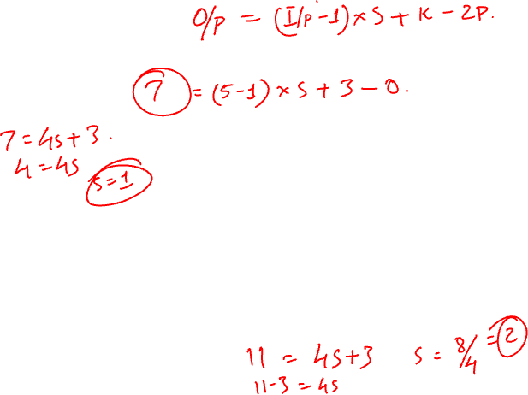
Transpose Convolution
CV 12: Semantic Segmentation and CV Metrics
3x3 Transpose Convolution, Stride 2, Pad 1
Output is filter F weighted by input I
I11 | I12
 | I22
Sum outputs at overlap (e.g., from I₁₁F and I₂₁F)
Example Credit: L. Fei-Fei, J. Johnson, S. Yeung

Slide 21
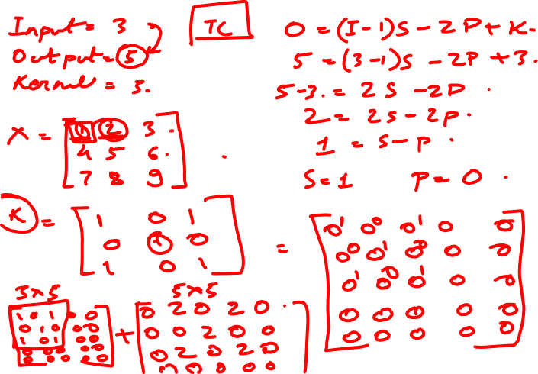
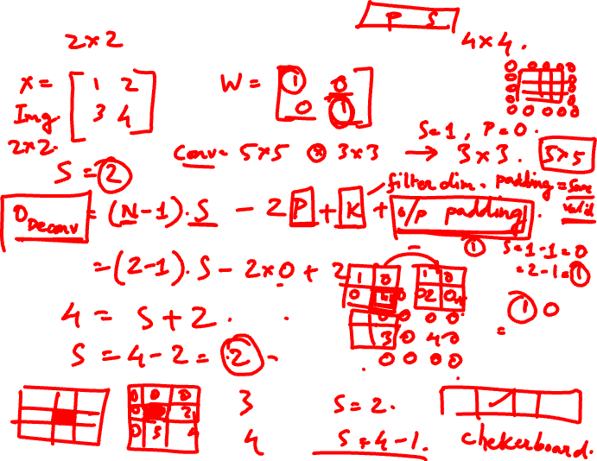
Notes:
Step 1: Find Stride and Padding
We want
Input = 3
Output = 5
Kernel = 3
Transpose convolution formula:
$$O=\left(I−1\right)S−2P+K$$
Substitute values:
$$5=\left(3−1\right)S−2P+3$$
$$5=2S−2P+3$$
$$2=2S−2P$$
$$1=S−P$$
One valid solution is
Stride = 1
Padding = 0
Check:
$$\left(3−1\right)×1−0+3=5$$
Correct.
Step 2: Input Feature Map
Suppose
$$X=\left[\begin{matrix}1 & 2 & 3 \\ 4 & 5 & 6 \\ 7 & 8 & 9\end{matrix}\right]$$
Kernel
$$W=\left[\begin{matrix}1 & 0 & 1 \\ 0 & 1 & 0 \\ 1 & 0 & 1\end{matrix}\right]$$
Step 3: How Standard Convolution Works
Normally we slide the kernel over the image.
Input
1 2 3
4 5 6
7 8 9
Kernel
1 0 1
0 1 0
1 0 1
One output pixel is produced from one 3×3 overlap.
Step 4: How Transpose Convolution Works
Instead of sliding the kernel over the image,
every input pixel "stamps" a weighted copy of the kernel onto the output.
Initially, the output is all zeros:
$$Y=\left[\begin{matrix}0 & 0 & 0 & 0 & 0 \\ 0 & 0 & 0 & 0 & 0 \\ 0 & 0 & 0 & 0 & 0 \\ 0 & 0 & 0 & 0 & 0 \\ 0 & 0 & 0 & 0 & 0\end{matrix}\right]$$
Pixel (0,0) = 1
Multiply the kernel by 1
$$1×W=\left[\begin{matrix}1 & 0 & 1 \\ 0 & 1 & 0 \\ 1 & 0 & 1\end{matrix}\right]$$
Place it at the top-left corner:
$$\left[\begin{matrix}1 & 0 & 1 & 0 & 0 \\ 0 & 1 & 0 & 0 & 0 \\ 1 & 0 & 1 & 0 & 0 \\ 0 & 0 & 0 & 0 & 0 \\ 0 & 0 & 0 & 0 & 0\end{matrix}\right]$$
Pixel (0,1) = 2
Multiply the kernel by 2
$$\left[\begin{matrix}2 & 0 & 2 \\ 0 & 2 & 0 \\ 2 & 0 & 2\end{matrix}\right]$$
Move one column to the right (stride = 1) and add it:
Existing
1 0 1 0 0
0 1 0 0 0
1 0 1 0 0
0 0 0 0 0
0 0 0 0 0
+
2 0 2
0 2 0
2 0 2
Result:
$$\left[\begin{matrix}1 & 2 & 1 & 2 & 0 \\ 0 & 1 & 2 & 0 & 0 \\ 1 & 2 & 1 & 2 & 0 \\ 0 & 0 & 0 & 0 & 0 \\ 0 & 0 & 0 & 0 & 0\end{matrix}\right]$$
Notice the overlapping values are added together.
Pixel (0,2) = 3
Stamp again one column further:
3 0 3
0 3 0
3 0 3
Again, overlapping entries are summed.
The same process continues for every element (4, 5, 6, 7, 8, 9), shifted according to its row and column position.
Why Does the Output Become 5×5?
Think about where the last kernel is placed.
The last input pixel is at position (2,2).
Its 3×3 kernel occupies:
Input coordinate : (2,2)
Kernel covers output coordinates
(2,2) (2,3) (2,4)
(3,2) (3,3) (3,4)
(4,2) (4,3) (4,4)
So the highest output index reached is 4.
Indices:
0 1 2 3 4
That's 5 rows × 5 columns.
Intuition
Standard Convolution
3×3 image
│
▼
One kernel slides over it
│
▼
One output pixel
Transpose Convolution
One input pixel
│
▼
Produces a 3×3 weighted patch
│
▼
All patches overlap and are added together
│
▼
Larger output feature map
This is the key conceptual difference:
Standard convolution: Many input pixels → One output pixel
Transpose convolution: One input pixel → Many output pixels (a kernel-sized patch), and overlapping patches are summed
This "stamping" interpretation is how deep learning libraries such as PyTorch and TensorFlow implement transpose convolution internally, and it's the easiest mental model for understanding why it increases spatial resolution.

Slide 22


Putting it Together
CV 12: Semantic Segmentation and CV Metrics
Convolutions + pooling downsample/compress/encode Transpose convs./unpoolings upsample/uncompress/decode
Input
Downsample Conv, pool “Encoder”
Upsample
Tr. Conv./Unpool “Decoder”
Output
C
_{W}F
W
H
H

Slide 23
Putting It Together – Block Sizes
CV 12: Semantic Segmentation and CV Metrics
Networks come in lots of forms
Don’t take any block sizes literally.
Often (not always) keep some spatial resolution
Encode to spatially smaller tensor, then decode.
Encode to 1D vector then decode

Slide 24

Putting It Together – Block Sizes
CV 12: Semantic Segmentation and CV Metrics
Often multiple layers at each spatial resolution.
Often halve spatial resolution and double feature
depth every few layers
H H/2 H/4 H/8 H/4 H/2 H W W/2 W/4 W/8 W/4 W/2 W D 2D 4D 8D 4D 2D D

Slide 25



Missing Details
CV 12: Semantic Segmentation and CV Metrics
While the output is HxW, just upsampling often produces results without details/not aligned with the image.
Why?
Information about details lost when downsampling!
Result from Long et al. Fully Convolutional Networks For Semantic Segmentation. CVPR 2014

Slide 26

Missing Details
CV 12: Semantic Segmentation and CV Metrics
Where is the useful information about the high-frequency details of the image?
A B C D E
Result from Long et al. Fully Convolutional Networks For Semantic Segmentation. CVPR 2014

Slide 27


Missing Details
CV 12: Semantic Segmentation and CV Metrics
How do you send details forward in the network?
You copy the activations forward.
Subsequent layers at the same resolution figure out how to fuse things.
Copy
Result from Long et al. Fully Convolutional Networks For Semantic Segmentation. CVPR 2014

Slide 28


U-Net
CV 12: Semantic Segmentation and CV Metrics
Extremely popular
architecture, was originally used for biomedical image segmentation.
Ronneberger et al. “U-Net: Convolutional Networks for Biomedical Image Segmentation. MICCAI 2015

Slide 29



Evaluating Pixel Labels
CV 12: Semantic Segmentation and CV Metrics
Input Image
Predicted Classes
F
F
W
W
CNN
H
H
How do we convert final HxWxF into labels?
argmax over labels

Slide 30




Evaluating Semantic Segmentation
CV 12: Semantic Segmentation and CV Metrics
Given predictions, how well did we do?
Input

Slide 31





Evaluating Semantic Segmentation
CV 12: Semantic Segmentation and CV Metrics
Prediction and ground-truth are images where each pixel is one of F classes.
Intersection over union, averaged over classes
/

Slide 32

.
CV 12: Semantic Segmentation and CV Metrics

Slide 33
Performance Metrics for Segmentation
- see materials
CV 12: Semantic Segmentation and CV Metrics

Slide 34





IoU (Intersection over union)
CV 12: Semantic Segmentation and CV Metrics
IoU measures the overlap between two boundaries.
We use that to measure how much our predicted boundary overlaps with the ground truth (the real object boundary).
In some datasets, we predefine an IoU threshold (say 0.5) in classifying whether the prediction is a true positive or a false positive.

Slide 35

mAP for Object Detection
CV 12: Semantic Segmentation and CV Metrics
Source: Karel Hora
Brno University of Technology / Czech Technical University in Prague
horak@feec.vutbr.cz

Slide 36



mAP for Object Detection
CV 12: Semantic Segmentation and CV Metrics
mAP stands for mean Average Precision.
AP is a popular metric in measuring the accuracy of object detectors like Faster R-CNN, SSD, etc.
Averageprecision computes the average precision valuefor recallvalueover 0 to 1. It sounds complicated but actually pretty simple as we illustrate it with an example.
But before that, we will do a quick recap on precision, recall, and IoU first.

Slide 37





Precision & recall
CV 12: Semantic Segmentation and CV Metrics
Precision measures how accurate is your predictions. i.e. the percentage of your predictions are correct.
Recall measures how good you find all the positives. For example, we can find 80% of the possible positive cases in our top K predictions.
F1 score is a measure combining Precision and Recall.

Slide 38



Numerical
IOU

Slide 39




Average Precision
CV 12: Semantic Segmentation and CV Metrics
Let us create an over-simplified example in demonstrating the calculation of the average precision.
In this example, the whole dataset contains five apples only. We collect all the predictions made for apples in all the images and rank it in descending order according to the predicted confidence level. The second column indicates whether the prediction is correct or not. In this example, the prediction is correct if IoU ≥ 0.5.

Slide 40

Average Precision
CV 12: Semantic Segmentation and CV Metrics
Let us take the row with rank #3 and demonstrate how precision and recall are calculated first.
Precision is the proportion of TP = 2/3 = 0.67.
Recall is the proportion of TP out of the possible positives = 2/5 = 0.4.
Recall values increase as we go down the prediction ranking. However, precision has a zigzag pattern
— it goes down with false positives and goes up again with true positives.

Slide 41





Average Precision
CV 12: Semantic Segmentation and CV Metrics
Let us plot the precision against the recall value to see this zig-zag pattern.
The general definition for the Average Precision (AP) is finding the area under the precision-recall curve.

Slide 42



Average Precision
CV 12: Semantic Segmentation and CV Metrics
Precision and recall are always between 0 and 1. Therefore, AP falls within 0 and 1 also.
Before calculating AP for the object detection, we often smooth out the zigzag pattern first.
Graphically, at each recall level, we replace each precision value with the maximum precision value to the right of that recall level.

Slide 43




Average Precision
CV 12: Semantic Segmentation and CV Metrics
So the orange line is transformed into the green line and the curve will decrease monotonically instead of the zigzag pattern.
The calculated AP value will be less susceptible to small variations in the ranking.
Mathematically, we replace the precision value for recall ȓ with the maximum precision for any recall
≥ ȓ.

Slide 44


Interpolated AP
CV 12: Semantic Segmentation and CV Metrics
PASCAL VOC is a popular dataset for object detection.
For the PASCAL VOC challenge, a prediction is positive if IoU ≥ 0.5. Also, if multiple detections of the same object are detected, it counts the first one as a positive while the rest as negatives.
In Pascal VOC2008, an average for the 11-point interpolated AP is calculated.

Slide 45


Interpolated AP
CV 12: Semantic Segmentation and CV Metrics
First, we divide the recall value from 0 to 1.0 into 11 points — 0, 0.1, 0.2, …, 0.9 and 1.0.
Next, we compute the average of maximum precision value for these 11 recall values.
In our example, AP = (5 × 1.0 + 4 × 0.57 + 2 × 0.5)/11

Slide 46


Assumptions used (standard object detection evaluation)
#GT = 6
IoU threshold = 0.5
Detections are processed in descending confidence
A detection counts as TP if IoU ≥ 0.5 and we still have an unmatched GT available (so TP cannot exceed 6; extra “good IoU” detections become FP due to duplicates)

Slide 47


Rank | Conf | IoU | TP/FP | TP cum | FP cum | Precision | Recall
1 | 0.99 | 0.64 | TP | 1 | 0 | 1.00 | 0.17
2 | 0.92 | 0.31 | FP | 1 | 1 | 0.50 | 0.17
3 | 0.92 | 0.31 | FP | 1 | 2 | 0.33 | 0.17
4 | 0.75 | 0.77 | TP | 2 | 2 | 0.50 | 0.33
5 | 0.72 | 0.51 | TP | 3 | 2 | 0.60 | 0.50
6 | 0.72 | 0.51 | TP | 4 | 2 | 0.67 | 0.67
7 | 0.71 | 0.45 | FP | 4 | 3 | 0.57 | 0.67
8 | 0.65 | 0.45 | FP | 4 | 4 | 0.50 | 0.67
9 | 0.61 | 0.70 | TP | 5 | 4 | 0.56 | 0.83
10 | 0.56 | 0.79 | TP | 6 | 4 | 0.60 | 1.00
11 | 0.42 | 0.53 | FP* | 6 | 5 | 0.55 | 1.00
Since the GT is 6 only even though the IOU is GT than 0.5 we dem it as FP
FP at rank 11 because we already reached 6 TPs (all GT matched). In normal matching, any additional detections are duplicates → FP.

Slide 48



9-point interpolation table (recall levels 0.1 to 0.9)
Recall level (r) | (p_interp}(r)
0.1 | 1.000
0.2 | 0.667
0.3 | 0.667
0.4 | 0.667
0.5 | 0.667
0.6 | 0.667
0.7 | 0.600
0.8 | 0.600
0.9 | 0.600

Slide 49




Slide 50


11-point interpolation table (recall levels 0.0 to 1.0)
Recall level (r) | (p_interp}(r)
0.0 | 1.000
0.1 | 1.000
0.2 | 0.667
0.3 | 0.667
0.4 | 0.667
0.5 | 0.667
0.6 | 0.667
0.7 | 0.600
0.8 | 0.600
0.9 | 0.600
1.0 | 0.600

Slide 51




Slide 52

Interpolated AP
CV 12: Semantic Segmentation and CV Metrics
When APᵣ turns extremely small, we can assume the remaining terms to be zero. i.e. we do not necessarily make predictions until the recall reaches 100%.
If the possible maximum precision levels drop to a negligible level, we can stop.
For 20 different classes in PASCAL VOC, we compute an AP for every class and also provide an average for those 20 AP results.
However, this interpolated method is an approximation which suffers two issues:
It is less precise.
Second, it lost the capability in measuring the difference for methods with low AP.
Therefore, a different AP calculation is adopted after 2008 for PASCAL VOC.

Slide 53

AP (Area under curve AUC)
CV 12: Semantic Segmentation and CV Metrics
For later Pascal VOC competitions, VOC2010–2012 samples the curve at all unique recall values (r₁, r₂, …), whenever the maximum precision value drops.
With this change, we are measuring the exact area under the precision-recall curve after the zigzags are removed.

Slide 54



AP (Area under curve AUC)
CV 12: Semantic Segmentation and CV Metrics
No approximation or interpolation is needed.
Instead of sampling 11 points, we sample p(rᵢ) whenever it drops and computes AP as the sum of the rectangular blocks.

Slide 55

COCO mAP
CV 12: Semantic Segmentation and CV Metrics
Latest research papers tend to give results for the COCO dataset only. In COCO mAP, a 101-point interpolated AP definition is used in the calculation.
For COCO, AP is the average over multiple IoU (the minimum IoU to consider a positive match).
AP@[.5:.95] corresponds to the average AP for IoU from 0.5 to 0.95 with a step size of 0.05.
For the COCO competition, AP is the average over 10 IoU levels on 80 categories (AP@[.50:.05:.95]: start from 0.5 to 0.95 with a step size of 0.05).

Slide 56


COCO mAP
CV 12: Semantic Segmentation and CV Metrics
The following are some other metrics collected for the COCO dataset:

Slide 57

COCO mAP
CV 12: Semantic Segmentation and CV Metrics
Example: the AP result for the YOLOv3 detector:
For clarity, AP@.75 means the AP with IoU=0.75.

Slide 58
COCO mAP
CV 12: Semantic Segmentation and CV Metrics
mAP (mean average precision) is the average of AP.
In some context, we compute the AP for each class and average them. But in some context, they mean the same thing. For example, under the COCO context, there is no difference between AP and mAP. Here is the direct quote from COCO:
„AP is averaged over all categories. Traditionally, this is called “mean average precision” (mAP). We make no distinction between AP and mAP (and likewise AR and mAR) and assume the difference is clear from context.“
In ImageNet, the AUC method is used.
To summarize: even all of them follow the same principle in measurement AP, the exact calculation may vary according to the datasets. Fortunately, development kits are available in calculating this metric.

Slide 59

CV 12: Semantic Segmentation and CV Metrics
Thank you
53

